Slide 1
Notes:
[An introduction of sorts…]

Slide 2
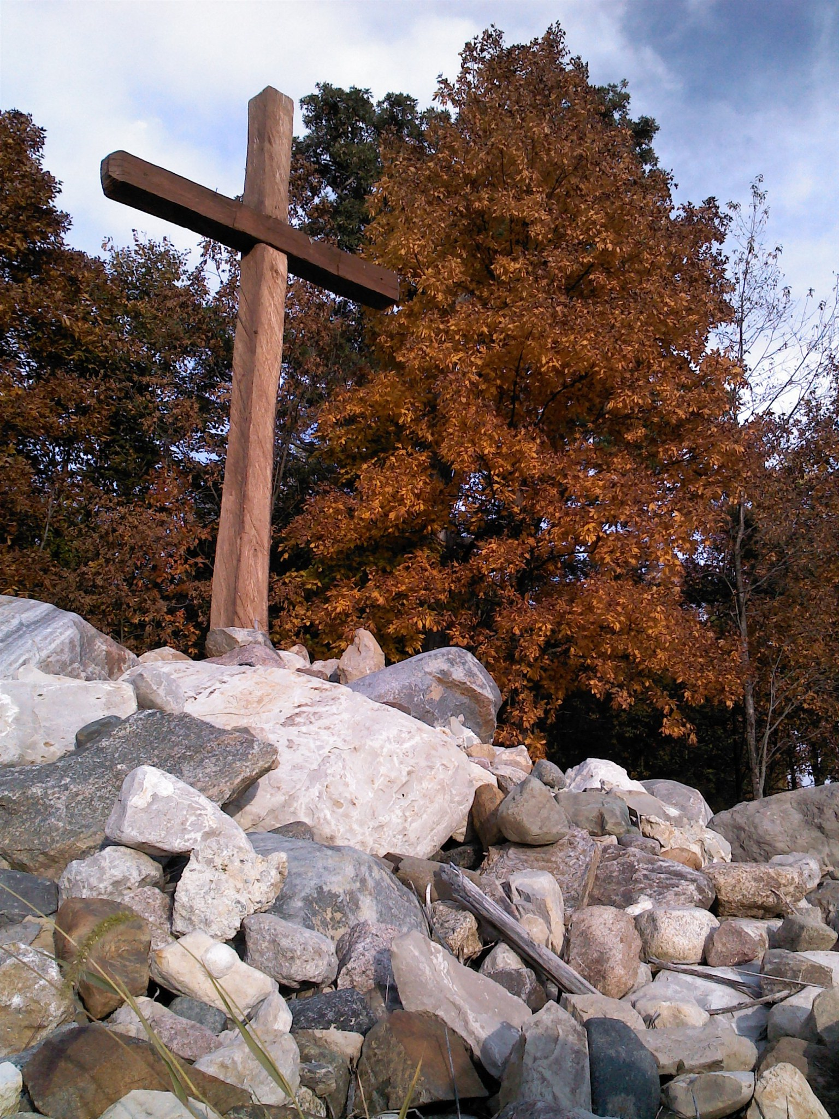
Seeds
& Gates
Notes:
Today I come to you to talk about Seeds and Gates. We’re going to start with Seeds. If you have your Bibles today, you CAN start by turning to Genesis 22:15-18. Buuut, I’m going to warn you that if you’re hoping to keep up with me as I go through the handful of scriptures that I came armed with this morning, I’m going to make you work for it! So you may be best served to just watch the screen.
As familiar as I am with the story of Abraham sacrificing his son Isaac, I was not familiar with the blessing that God pronounced over them after Abraham had passed his test. I thought I was, but when I was put to the test by my friend Tammy earlier this week, I found that I was sadly mistaken. This passage of scripture is critical to us as Christians today. So critical that I couldn’t let another moment pass before I shared it with you with fresh eyes.

Slide 3
The Blessing of Abraham
Genesis 22:¹⁵ Then the Angel of the Lord called to Abraham a second time from heaven ¹⁶ and said, “By Myself I have sworn,” this is the Lord’s declaration: “Because you have done this thing and have not withheld your only son, ¹⁷ I will indeed bless you and make your offspring as numerous as the stars of the sky and the sand on the seashore.
Notes:
Now this is the part that we’re all plenty familiar with. It’s the blessing that has been repeated over Abraham over and over since the beginning of his story. God has promised to bless him with more descendants than the stars in the sky and the sand on the seashore. But this next part is what truly blew me away this week.

Slide 4
The Blessing of Abraham’s Seed
The Blessing of Abraham
Genesis 22:¹⁵ Then the Angel of the Lord called to Abraham a second time from heaven ¹⁶ and said, “By Myself I have sworn,” this is the Lord’s declaration: “Because you have done this thing and have not withheld your only son, ¹⁷ I will indeed bless you and make your offspring as numerous as the stars of the sky and the sand on the seashore. Your offspring will possess the gates of their enemies. ¹⁸ And all the nations of the earth will be blessed by your offspring because you have obeyed My command.”
Notes:
Those words were spoken over both Abraham AND Isaac! Isaac HEARD those words from the mouth of God Himself! Can you imagine!?! But then if we fast forward in the story just two more chapters we find something even more amazing. Our next stop in our tour through the scripture today is the blessing of Rebekah in Genesis 24. This is where her family members are sending her off to live with Isaac after the death of his mother Sarah. And they say to her…

Slide 5
The Blessing of Abraham’s Seed
The Blessing of Abraham’s Seed
The Blessing of Rebekah
Our sister, may you become
thousands upon ten thousands.
May your offspring possess
the gates of his enemies.
Notes:
Did you catch that? They said almost the exact same thing that God said over Abraham and Isaac!!! I want to take a look at these two blessings side by side for a minute so that we can fully appreciate their similarities.

Slide 6
Rebekah’s Blessing
Abraham’s Blessing
The Blessing of Abraham’s Seed
The Blessing of Abraham’s Seed
*Our sister, may you become thousands upon ten thousands.
*I will indeed bless you and make your offspring as numerous as the stars of the sky and the sand on the seashore.

Slide 7
Rebekah’s Blessing
Abraham’s Blessing
The Blessing of Abraham’s Seed
The Blessing of Abraham’s Seed
*Our sister, may you become thousands upon ten thousands.
*May your offspring possess the gates of his enemies.
*I will indeed bless you and make your offspring as numerous as the stars of the sky and the sand on the seashore.
*Your offspring will possess the gates of their enemies.
Notes:
Now here I’ve just got to point out something in the wording of these two blessings. While Rebekah’s is spoken with all “may”s. May you become… May your offspring possess. Abraham’s blessing is spoken with all “will”s. I will indeed bless you… Your offspring WILL posses the gates of their enemies. While Rebekah’s family is wishing her good tidings of great joy, God is proclaiming that it WILL certainly happen. Period. He is God and has spoken. And then just like God to throw an extra blessing in, we’ve got one more point in Abraham’s blessing:

Slide 8
Rebekah’s Blessing
Abraham’s Blessing
The Blessing of Abraham’s Seed
The Blessing of Abraham’s Seed
*Our sister, may you become thousands upon ten thousands.
*May your offspring possess the gates of his enemies.
*I will indeed bless you and make your offspring as numerous as the stars of the sky and the sand on the seashore.
*Your offspring will possess the gates of their enemies.
*And all the nations of the earth will be blessed by your offspring because you have obeyed My command.
Notes:
And what was it that His offspring were blessed with because of he obeyed the command? The possession of the gates of their enemies.
Now I want to change a critical word in each of these blessings because it’s key to my point today. While the Hebrew word “Zera” can be translated to mean offspring – which it often is. It’s literal meaning in Hebrew is “seed”.

Slide 9
Rebekah’s Blessing
Abraham’s Blessing
The Blessing of Abraham’s Seed
The Blessing of Abraham’s Seed
*Our sister, may you become thousands upon ten thousands.
*May your SEED possess the gates of his enemies.
*I will indeed bless you and make your SEED as numerous as the stars of the sky and the sand on the seashore.
*Your SEED will possess the gates of their enemies.
*And all the nations of the earth will be blessed by your SEED because you have obeyed My command.
Notes:
This one word is so critical because we find it again in Galatians 3:16-18

Slide 10
The Blessing of Abraham’s Seed
The Blessing of Abraham’s Seed
Galatians 3:16-18
¹⁶ Now the promises were spoken to Abraham and to his seed. He does not say “and to seeds,” as though referring to many, but referring to one, and to your seed, who is Christ. ¹⁷ And I say this: The law, which came 430 years later, does not revoke a covenant that was previously ratified by God and cancel the promise.
Notes:
I’m going to pause in talking about seeds so that I can speak about gates for a minute and then we’ll bring them both together for something really amazing.
So, while I’m assuming that most of you are fairly familiar with the purpose and function of a gate, like any good teacher I’ve got to establish a baseline for our information here.

Slide 11
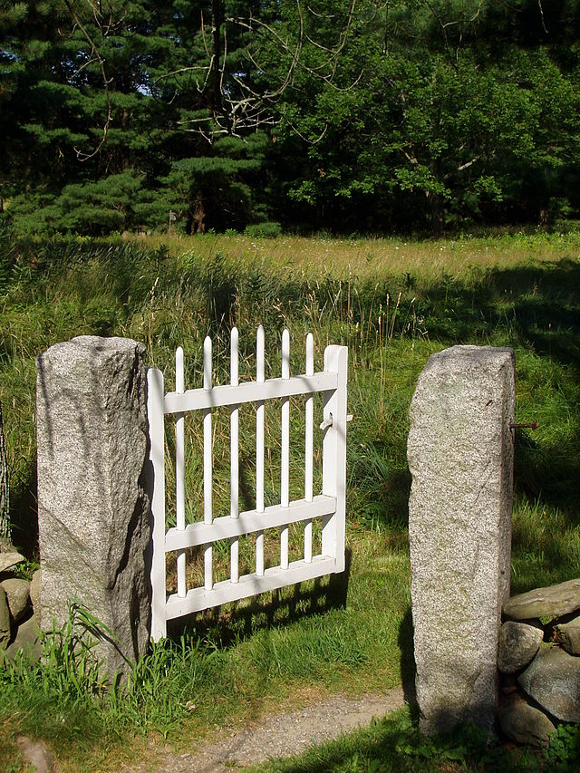
Gates
A gate or gateway is a point of entry to a space enclosed by walls, or a moderately sized opening in some sort of fence. Gates may prevent or control the entry or exit of individuals, or they may be merely decorative.
Notes:
Now, for the sake of being thorough I’m going to take this a step further and also read the definition of a City Gate with you.

Slide 12
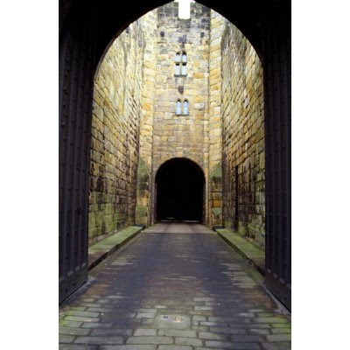
City Gates
City gates were traditionally built to provide a point of controlled access to and departure from a walled city for people, vehicles, goods and animals. Depending on their historical context they filled functions relating to defense, security, health, trade, taxation, and representation, and were correspondingly staffed by military or municipal authorities.

Slide 13
The city gate was also commonly used to display diverse kinds of public information such as announcements, tax and toll schedules, standards of local measures, and legal texts. It could be heavily fortified, ornamented with heraldic shields, sculpture or inscriptions, or used as a location for warning or intimidation, for example by displaying the heads of beheaded criminals or public enemies.

Slide 14
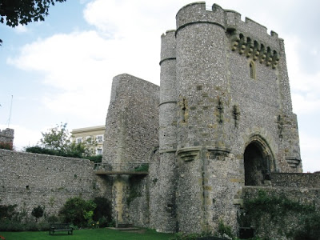
Gates
Notes:
It was behind walls just like these that people lived their everyday normal lives. Protected from whatever enemy forces stood outside those walls. They trusted in the gate because it was guarded from ALL sides by men with deadly weapons. However, if the gate could somehow be taken by that enemy force, the whole city was bound to be taken. The gate was the most critical point in the entire city’s defense. Mainly because it was the weakest point in the defense.
Generally, the city was surrounded by walls made of rock several feet thick. Basically impenetrable. The best and only place that many people could move through the wall at once was through the gate. So you can see why it would be incredibly important to have a strong gate to withstand any enemy force that could possibly come against your city. Let’s take a look and see what John 10:7 has to say to us about gates today shall we?

Slide 15
The Blessing of Abraham’s Seed
John 10:7
The Blessing of Abraham’s Seed
⁷ Therefore Jesus said again, “Very truly I tell you,
I am the gate for the sheep.
⁸ All who have come before me are thieves and robbers, but the sheep have not listened to them.
⁹ I am the gate;
whoever enters through me will be saved. They will come in and go out, and find pasture. ¹⁰ The thief comes only to steal and kill and destroy; I have come that they may have life, and have it to the full.
Notes:
Jesus is OUR gate into the kingdom of heaven! Probably not new news, but it’s still GOOD news! So how is that significant for us today? To learn more about that we need to look at Jesus a little more. Our next stop in this journey through the word is going to be the Mount of Transfiguration in Luke. At the top of the mountain Jesus is chatting it up with Moses and Elijah, Luke 9:31 tells us what exactly they were talking about.

Slide 16
The Blessing of Abraham’s Seed
The Blessing of Abraham’s Seed
Luke 9:31
³¹ They appeared in glory and were speaking of His death, which He was about to accomplish in Jerusalem.
Notes:
The death which HE was about to accomplish!!! HE did it, not anyone else. If we glance back to John 10:17-18 we’ll see what He means.

Slide 17
The Blessing of Abraham’s Seed
The Blessing of Abraham’s Seed
John 10:17-18
¹⁷ This is why the Father loves Me, because I am laying down My life so I may take it up again. ¹⁸ No one takes it from Me, but I lay it down on My own. I have the right to lay it down, and I have the right to take it up again. I have received this command from My Father.”
Notes:
I spent about an hour and a half the other day translating these two verses straight from the original Greek. There are a few nuances that I just loved about the passage. Jesus talks about His life as though it were as easy to lay down and pick up as taking a coat off His shoulders and laying it down on the ground and then picking it back up again. Yet the part where He says that no one takes it from Him is STRONG. It’s a phrase that carries a distinct negativity. As in there is absolutely positively NO ONE that could ever take His life from Him. And when He talks about the authority He possess, it’s that same feeling of certainly attached to it. This translation uses the word “right” to lay it down and I have the “right” to take it up again, but in the original Greek it’s really definitely a word used for authority and power. The writer of Hebrews refers to the life of Jesus as “indestructible” (7:16) and I believe that this verse backs that Truth up. But what’s more is that because we have been born of God and given the Spirit of Christ through the Holy Spirit, that means that we too possess this “indestructible life”. So what does that have to do with seeds and gates? Lets move on to Matthew 16:13-18 to find out!

Slide 18
The Blessing of Abraham’s Seed
The Blessing of Abraham’s Seed
Matthew 16:13-19
¹³ When Jesus came to the region of Caesarea Philippi, he asked his disciples, “Who do people say the Son of Man is?”
¹⁴ They replied, “Some say John the Baptist; others say Elijah; and still others, Jeremiah or one of the prophets.”
¹⁵ “But what about you?” he asked. “Who do you say I am?”

Slide 19
The Blessing of Abraham’s Seed
The Blessing of Abraham’s Seed
Matthew 16:13-19
¹⁶ Simon Peter answered, “You are the Messiah, the Son of the living God.”
¹⁷ Jesus replied, “Blessed are you, Simon son of Jonah, for this was not revealed to you by flesh and blood, but by my Father in heaven. ¹⁸ And I tell you that you are Peter, and on this rock I will build my church, and the gates of Hades will not overcome it. ¹⁹ I will give you the keys of the kingdom of heaven; whatever you bind on earth will be bound in heaven, and whatever you loose on earth will be loosed in heaven.”
Notes:
Now there’s another little nuance in the Greek that is lost here in the English that I can’t pass by without pointing it out on our tour. It’s the name of Peter and the word “rock”.

Slide 20
The Blessing of Abraham’s Seed
The Blessing of Abraham’s Seed
Matthew 16:13-19
¹⁶ Simon Peter answered, “You are the Messiah, the Son of the living God.”
¹⁷ Jesus replied, “Blessed are you, Simon son of Jonah, for this was not revealed to you by flesh and blood, but by my Father in heaven. ¹⁸ And I tell you that you are Peter, and on this rock I will build my church, and the gates of Hades will not overcome it. ¹⁹ I will give you the keys of the kingdom of heaven; whatever you bind on earth will be bound in heaven, and whatever you loose on earth will be loosed in heaven.”
Notes:
Peter = Petros = a name that means a detached stone or boulder one that could be thrown or easily moved
Rock = Petra = denotes a mass of rock, like bedrock.

Slide 21
The Blessing of Abraham’s Seed
The Blessing of Abraham’s Seed
Matthew 16:13-19
¹⁶ Simon Peter answered, “You are the Messiah, the Son of the living God.”
¹⁷ Jesus replied, “Blessed are you, Simon son of Jonah, for this was not revealed to you by flesh and blood, but by my Father in heaven. ¹⁸ And I tell you that you are Peter, and on this rock I will build my church, and the gates of Hades will not overcome it. ¹⁹ I will give you the keys of the kingdom of heaven; whatever you bind on earth will be bound in heaven, and whatever you loose on earth will be loosed in heaven.”
Notes:
This is the Truth.
This is the Truth that will make verse 18 possible for all who believe.

Slide 22
The Blessing of Abraham’s Seed
The Blessing of Abraham’s Seed
Matthew 16:13-19
¹⁸ And I tell you that you are Peter, and on this rock I will build my church, and
the gates of Hades will not overcome it.
¹⁹ I will give you the keys of the kingdom of heaven; whatever you bind on earth will be bound in heaven, and whatever you loose on earth will be loosed in heaven.”
Notes:
That’s a PROMISE! It’s a Truth, THE Truth and nothing but the Truth! Our homes are built within the walls of the Kingdom of God where the gate, the weakest point in the wall, is JESUS! If God is for us then who can be against us? If you think that’s good, just wait for our next stop! John 14:30. Jesus is talking with His disciples just after the Last Supper when He says,

Slide 23
The Blessing of Abraham’s Seed
The Blessing of Abraham’s Seed
John 14:30
³⁰ I will not talk with you much longer, because the ruler of the world is coming. He has no power over Me. ³¹ On the contrary, I am going away so that the world may know that I love the Father. Just as the Father commanded Me, so I do.
Notes:
If you want a power phrase over the Enemy, that’s one for your record book right there! If you got a pencil, write that one down on your bulletin! John 14:30. Because I PROMISE YOU, if you are feeling overwhelmed by the Enemy, speak these words. “He has no power over ME”. He doesn’t my friend. He wants you to THINK that he does. But that power has been taken from him at the tip of a sword as it spilled Jesus’ blood and water at the cross proving His sacrificial death to everyone present. And you’d better believe that later that day, Satan could be found weeping into pillowcase. He had lost the election. A new King was stepping up to the throne.
According to Galatians 3:28-29…

Slide 24
The Blessing of Abraham’s Seed
The Blessing of Abraham’s Seed
Galatians 3:28-29
²⁸ There is no Jew or Greek, slave or free, male or female; for you are all one in Christ Jesus. ²⁹ And if you belong to Christ,
Then you are Abraham’s seed, heirs according to the promise.
Notes:
YOU. That promise that God spoke over Isaac and Rebekah, it applies to you today, every word of it.

Slide 25
The Blessing of Abraham’s Seed
The Blessing of Abraham’s Seed
The Blessing of Abraham
¹⁷ I will indeed bless you and make your offspring as numerous as the stars of the sky and the sand on the seashore. Your offspring will possess the gates of their enemies. ¹⁸ And all the nations of the earth will be blessed by your offspring because you have obeyed My command.”
Notes:
I’m going to close with just one more verse. It’s a verse that I want you to treasure in your heart as you ponder all the verses before this one. Romans 8:35-37

Slide 26
The Blessing of Abraham’s Seed
The Blessing of Abraham’s Seed
Romans 8:35-37
³⁵ Who shall separate us from the love of Christ? Shall trouble or hardship or persecution or famine or nakedness or danger or sword?
³⁶ As it is written:
“For your sake we face death all day long;
we are considered as sheep to be slaughtered.”
³⁷ No, in all these things we are more than conquerors through him who loved us.
Notes:
Now let’s go out there, and knock down the Gates of Hell!!!

Slide 27
The Blessing of Abraham’s Seed
The Blessing of Abraham’s Seed

